Slide 1
Module 6: Manage communication in Microsoft Teams

Slide 2
Module agenda
Manage Live event and meetings experiences
Manage phone numbers
Manage Phone System for Microsoft Teams
Troubleshot audio, video and client issues

Slide 3
Manage Live event and meetings experiences

Slide 4
Lesson introduction
After this lesson, you will be able to:
Understand meetings and conferencing in Microsoft Teams
Set up conference bridges
Manage meeting policies
Configure meeting settings
Explain Live events in Microsoft Teams
Manage Live events policies
Configure Live events settings

Slide 5
Overview of meetings and conferencing in Microsoft Teams
Three types of meetings:
Private meeting
Channel meeting
Ad-hoc meeting (Meet now)
Meeting policies
Licensing
Transcription service
Notes:
Supporting videos for instructor or student use:
Introduction to Meetings in Microsoft Teams for IT Pros
https://www.youtube.com/watch?v=redE59lo2_Y&list=PLaSOUojkSiGnKuE30ckcjnDVkMNqDv0Vl&index=4

Slide 6
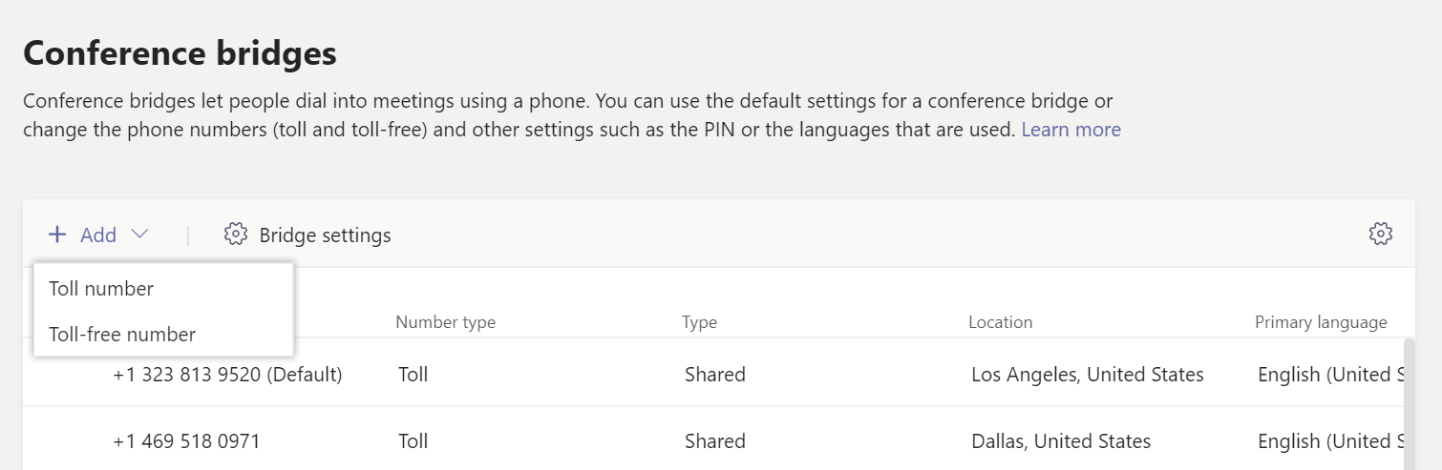
Configure conference bridges
Adding additional conference bridge numbers
Define a default conference bridge number
Configuring conference bridges settings in Teams admin center

Slide 7
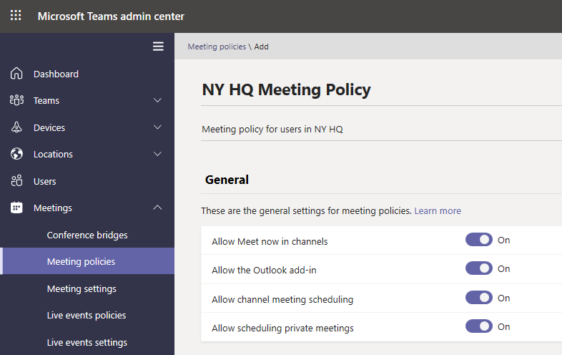
Manage meetings policies
Apply meeting policies:
Per organizer
Per user
Per organizer and per user
Create a new meeting policy
Assign meeting policy to a user
Create and configure a meeting policy using PowerShell

Slide 8
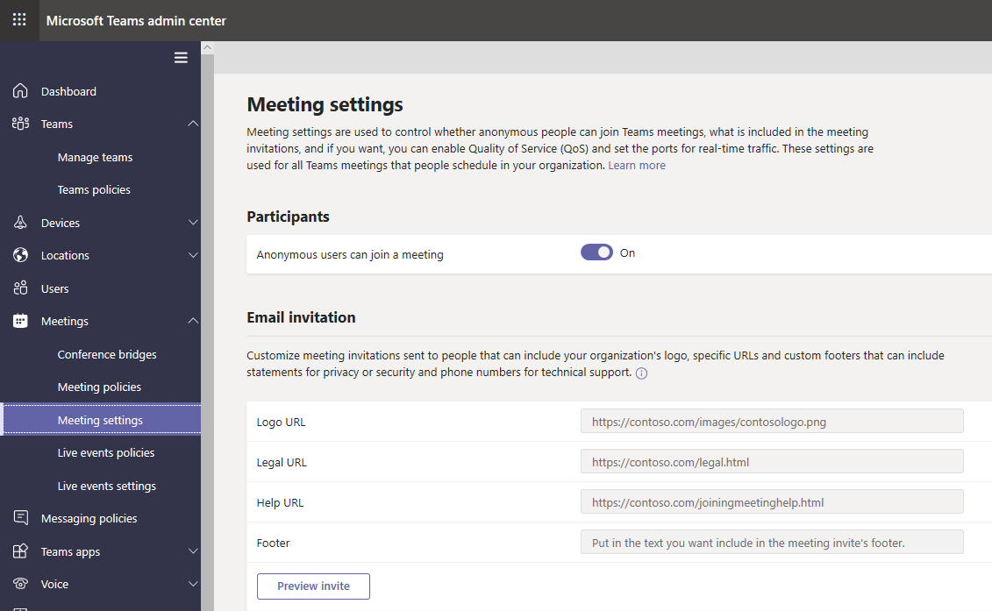
Manage meeting settings
Meetings settings:
Participants (anonymous join)
Email invitation (customization)
Network settings
Configure Meeting settings in Teams admin center

Slide 9
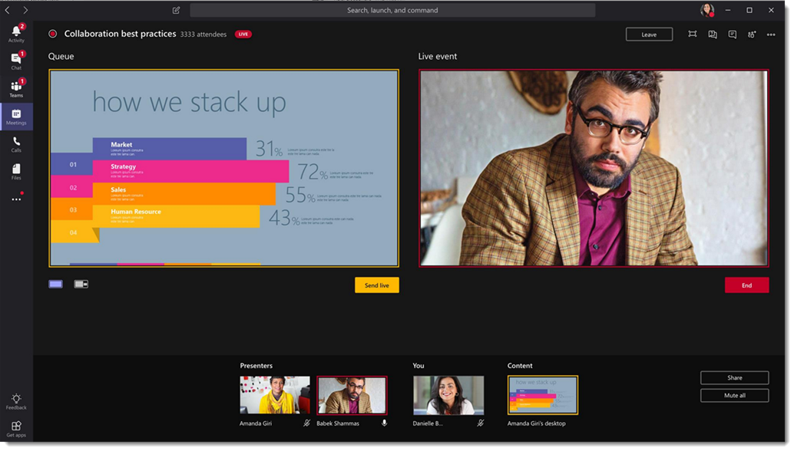
Overview of live events in Microsoft Teams
Broadcast video and meeting content online to large audiences:
Event group roles
User requirements for creating live events
Who can attend live events
Live events components
Enterprise Content Delivery Network
Attendee experience
Live event usage report
Notes:
Supporting videos for instructor or student use:
Live Events in Microsoft Teams
https://www.youtube.com/watch?v=0pnfFsUtaDQ&list=PLaSOUojkSiGnKuE30ckcjnDVkMNqDv0Vl&index=16&t=0s

Slide 10
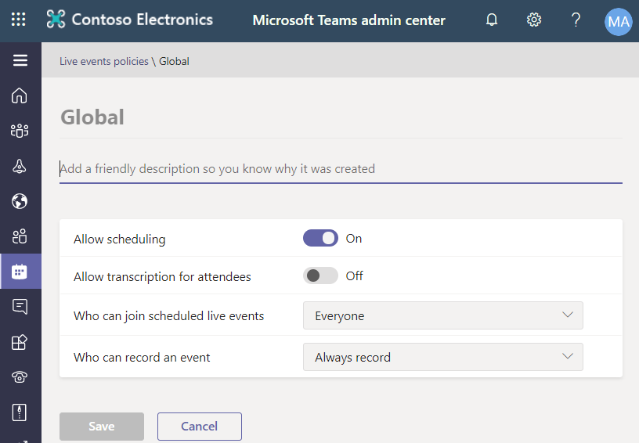
Manage live event policies
Use live event policies to control who can do what in live events in your organization:
Default live events policy
Create or edit a live events policy
Assign a policy to users
Manage policies using PowerShell

Slide 11
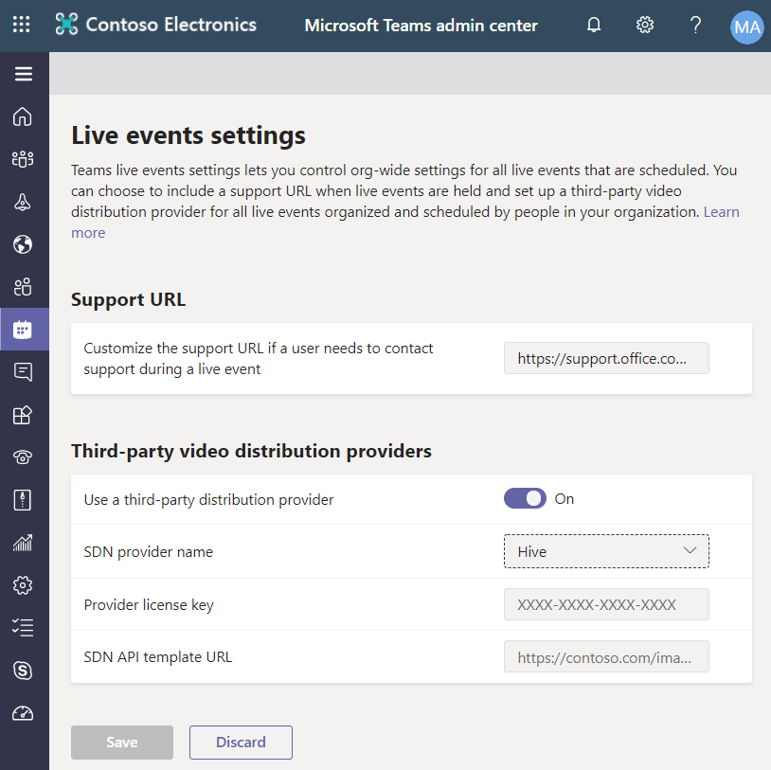
Manage live event settings
Manage live event settings:
Use a third-party distribution provider
SDN provider name
Provider license key
SDN API template URL
Set up Support URL using Windows PowerShell
Configure third-party video provider using Windows PowerShell

Slide 12
Manage phone numbers

Slide 13
Lesson introduction
After this lesson, you will be able to:
Evaluate PSTN connectivity solution
Explain how to get new phone numbers
Manage emergency addresses
Manage phone numbers for users
Manage voice settings for users

Slide 14
Evaluate PSTN connectivity solutions
PSTN connectivity can be established in two ways:
Calling Plan
Domestic Calling Plan
Domestic and International Calling Plan
Direct Routing
Infrastructure requirements for Direct Routing:
Supported SBC
A public DNS FQDN and a public IP address and that will be used to connect to the SBC
A public trusted certificate for the SBC that will be used for communication with Direct Routing
Firewall IP addresses and ports opened for Direct Routing and Microsoft Teams media
Media Transport Profile should allow TCP/RTP/SAVP and UDP/RTP/SAVP
Media traffic codecs
Notes:
Supporting videos for instructor or student use:
Direct Routing in Microsoft Teams
https://www.youtube.com/watch?v=1ASftX_Msb8

Slide 15
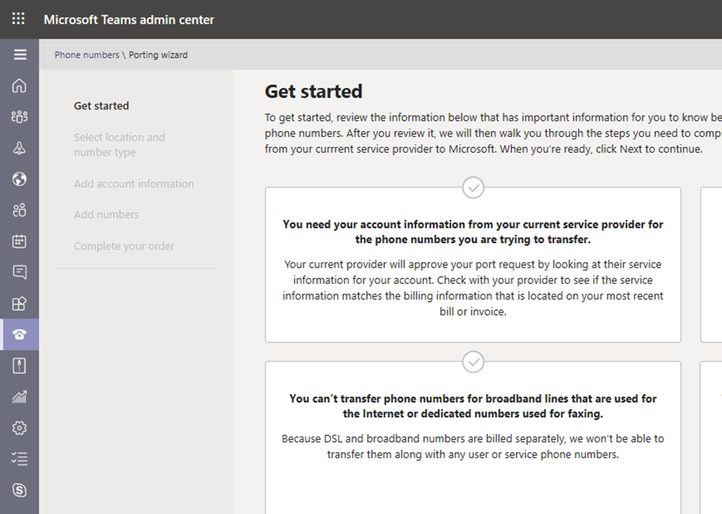
Get phone numbers
Three ways to get phone numbers:
Use the Microsoft Teams admin center
Port your existing numbers
Use a request form for new numbers
Two types of phone numbers:
User numbers
Service numbers
Set phone numbers in Microsoft Teams Admin Center

Slide 16
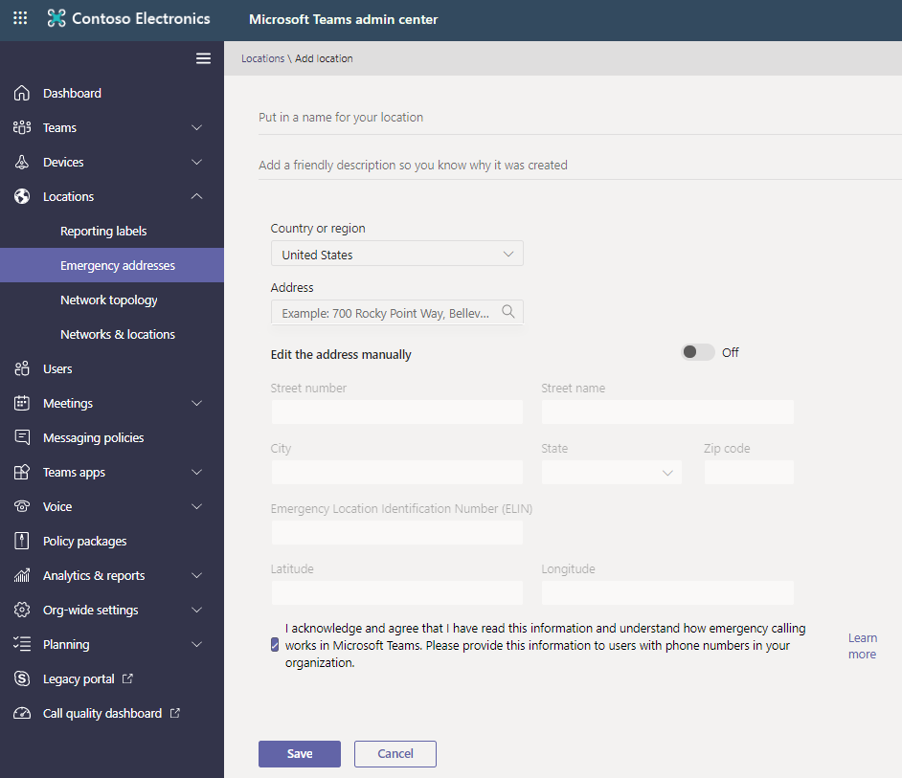
Manage emergency addresses
Add emergency locations
Change an emergency location
Remove an emergency location
Notes:
Plan for emergency locations :make a list of all physical addresses decide on emergency locations

Slide 17
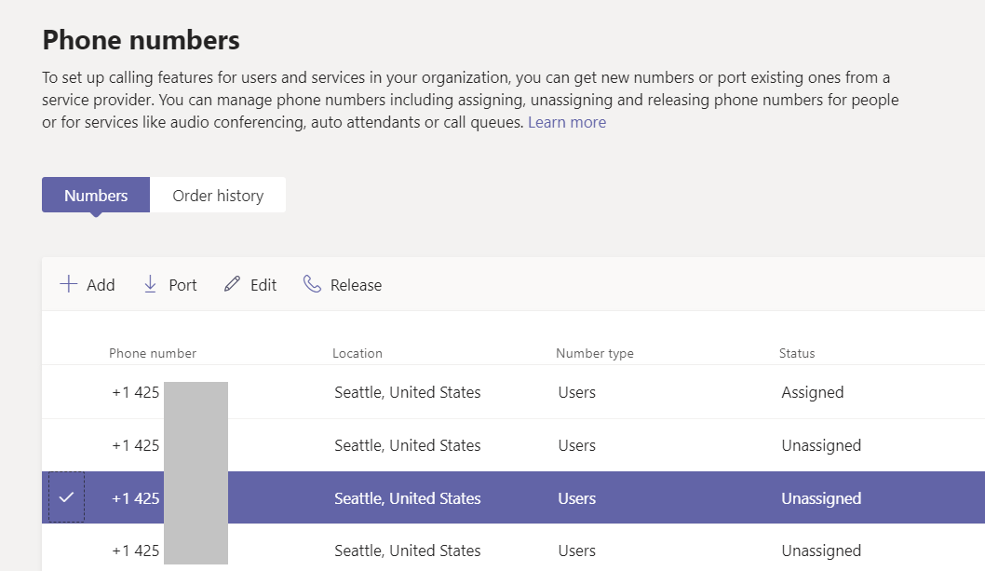
Manage phone numbers for users
Assigning phone numbers in the Teams admin center
Change a phone number for a user
Remove a phone number for a user

Slide 18
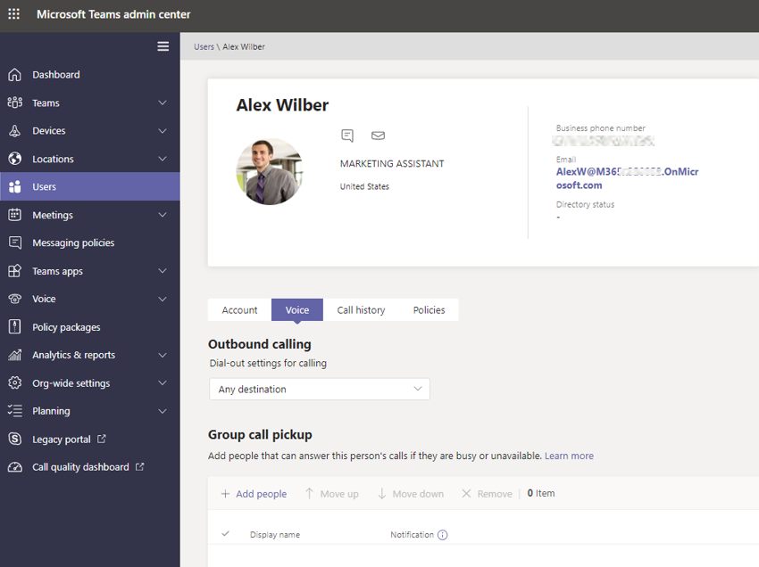
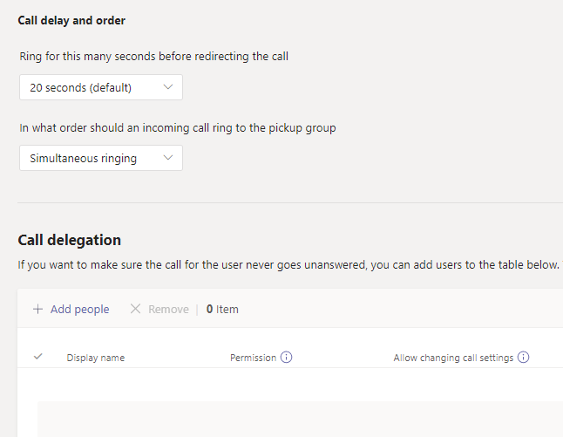
Manage voice settings for users
Notes:
Call sharing
Group call pickup
Use Skype for Business Online PowerShell module to enable or disable call pick up policies

Slide 19
Manage phone system

Slide 20
Lesson Introduction
After this lesson, you will be able to:
Create and manage resource accounts
Create and manage call queues
Create and manage auto attendants
Configure call park policies
Configure policies to manage calling capabilities
Describe Teams Direct Routing
Explain Teams addon licensing

Slide 21
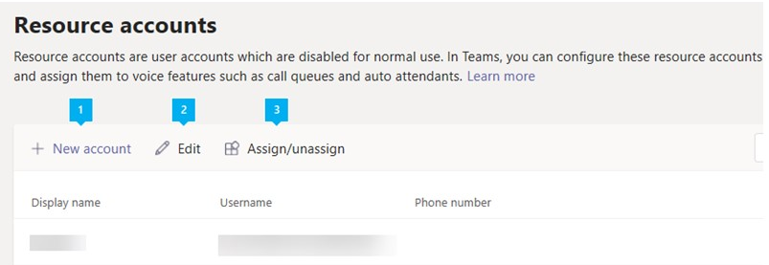
Manage resource accounts
A resource account is a disabled user object in Azure AD. Phone System call queues and auto attendants must have at least one associated resource account in Microsoft Teams:
Create a resource account with a phone number
Create a resource account without a phone number
Create a resource account in Microsoft Teams admin center
Manage Resource account settings in Microsoft Teams admin center
Create a resource account in PowerShell

Slide 22
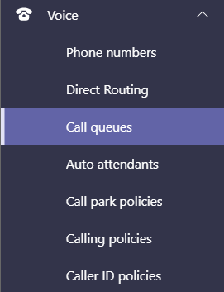
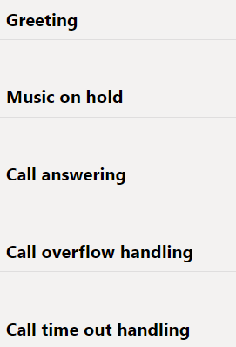
Create and configure a call queue
Start with creating call queue
Get or transfer toll or toll-free service phone numbers
Create a new call queue
Routing method
Select an agent opt-out option
Set the call overflow and timeout handling options
Call queue cmdlets

Slide 23
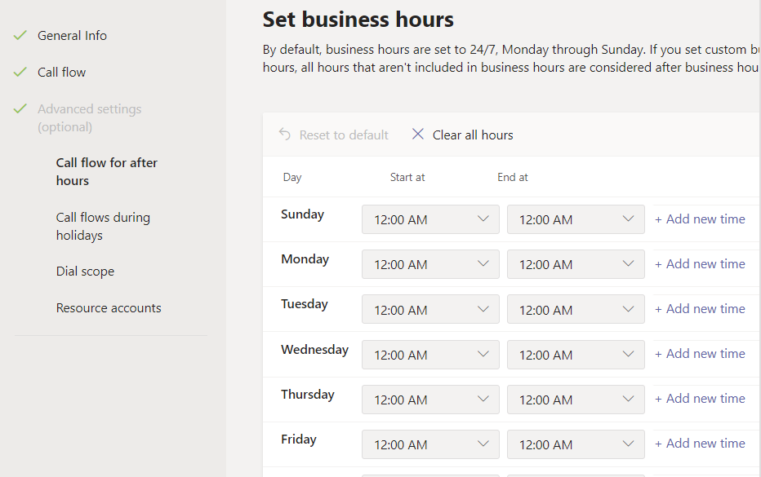
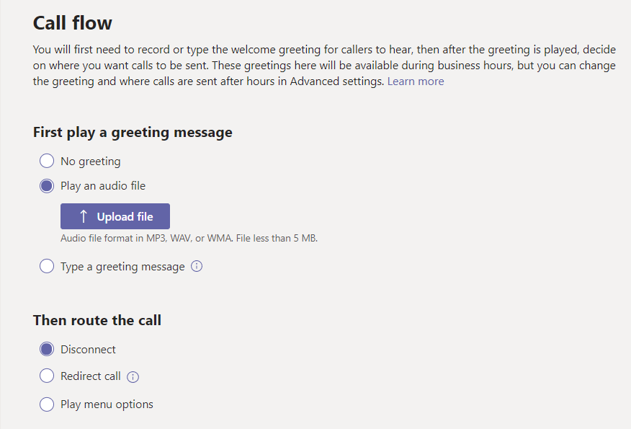
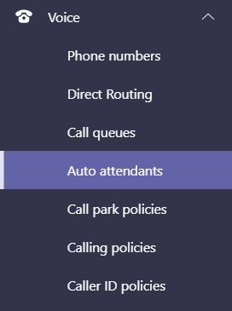
Create and configure an auto attendant
Set up an auto attendant with an existing resource account
Assign phone numbers for an auto attendant
Search for users
Set menu options

Slide 24
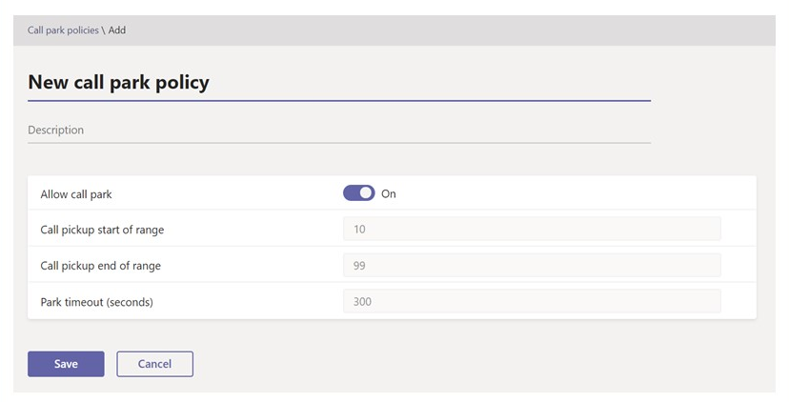
Manage call park policies
Call park enables a user to place a call on hold in the Teams service in the cloud:
Enable a call park policy
Assign a call park policy
Configure call park and retrieve with PowerShell
Troubleshooting call parking

Slide 25
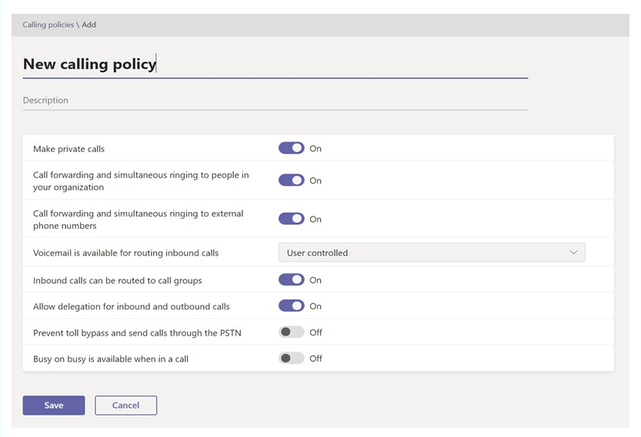
Manage calling policies
Create a custom calling policy
Modify an existing calling policy
Assign a calling policy to a user
Calling policy settings

Slide 26
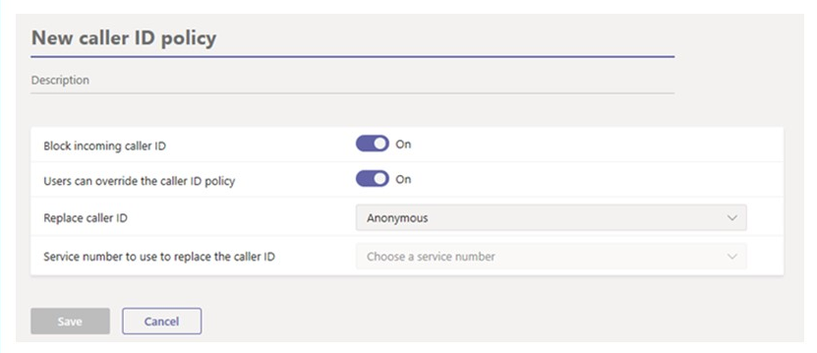
Manage caller ID Policies
Caller ID policies in Microsoft Teams can help you change or block the caller:
Create a custom caller ID policy
Edit a caller ID policy
Assign a custom caller ID policy to users through PowerShell

Slide 27
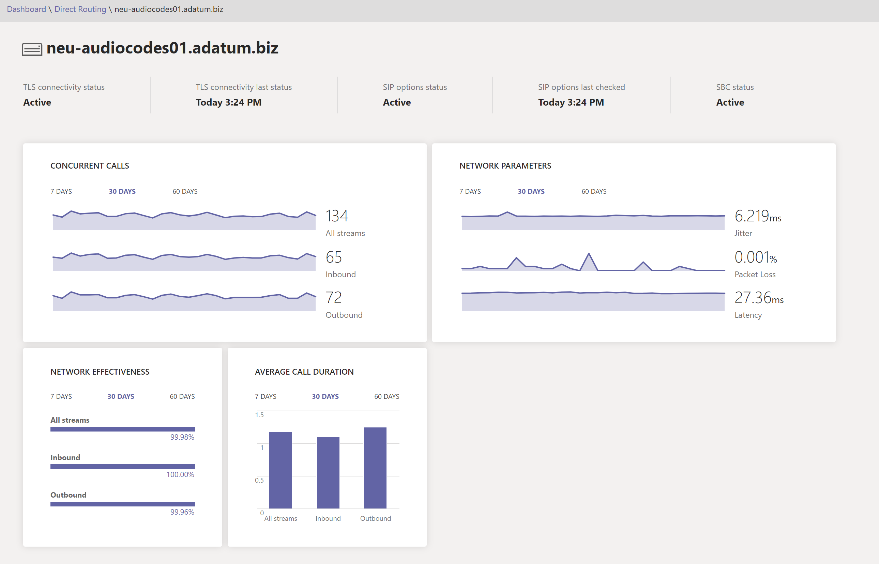
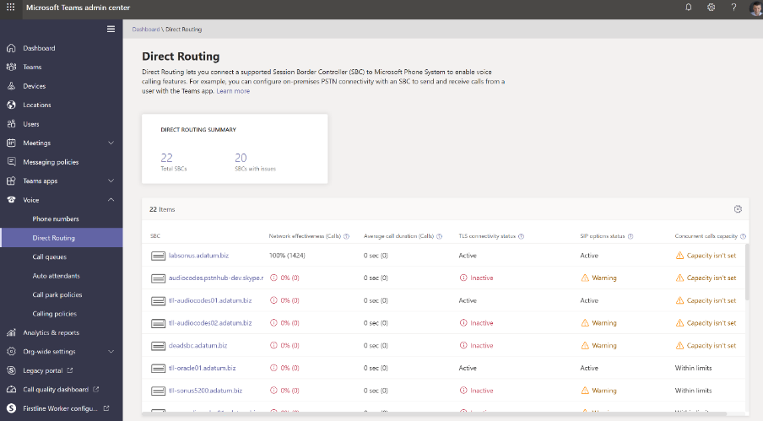
Direct Routing health dashboard
Monitor the connection between your Session Border Controller and the Direct Routing interface:
Overall health
Detailed information for each SBC
Network Effectiveness Ratio

Slide 28
Microsoft Teams add-on licensing
Audio Conferencing
Toll free numbers
Phone System
Calling Plans:
Domestic Calling Plans
Domestic and International Calling Plans
Microsoft Teams Rooms

Slide 29
Troubleshot audio, video and client issues

Slide 30

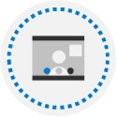

Lesson Introduction
After this lesson, you will be able to:
Describe key aspects of Teams troubleshooting
Optimize call quality by using Call Analytics
Analyze call quality by using Call Quality Dashboard

Slide 31
Troubleshoot overview
Troubleshooting connectivity issues with the Microsoft Teams client
Clear Microsoft Teams client cache (Windows, Android and iOS)
Use log files in troubleshooting Microsoft Teams
Debug logs or Diagnostic logs
Teams coexistence troubleshooting with Skype for Business users:
Using coexistence modes for troubleshooting
Investigating External or Federation communication
Notes:
Supporting videos for instructor or student use:
Troubleshooting Microsoft Teams
https://myignite.techcommunity.microsoft.com/sessions/83474?source=sessions

Slide 32
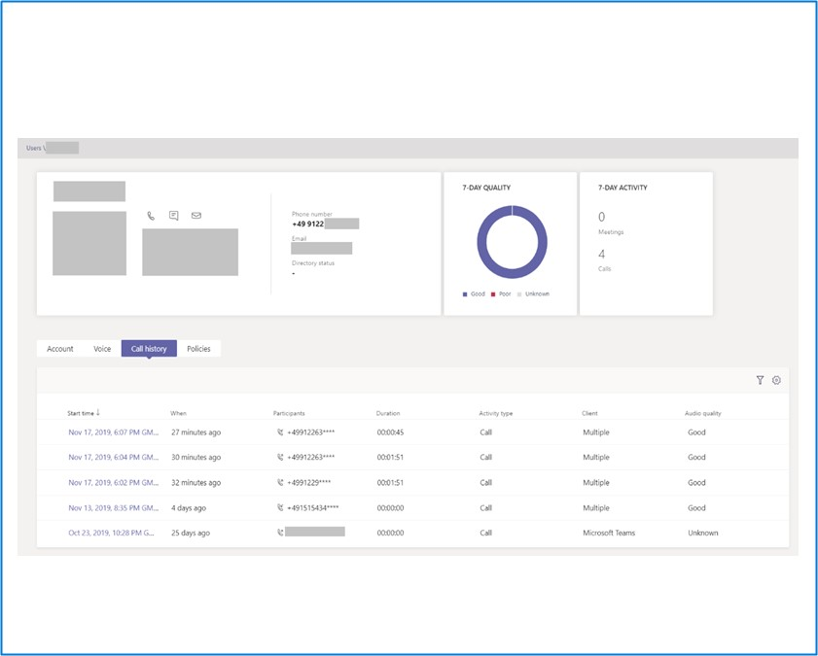
Optimize call quality by using Call Analytics
Troubleshoot call or connection problems with Microsoft Teams.
Call analytics permissions*:
Teams admin role
Teams communication support specialist
Teams communication support engineer
Troubleshoot call quality problems using Call Analytics
*The roles have different types of information access
Notes:
Supporting videos for instructor or student use:
Troubleshooting Microsoft Teams
https://myignite.techcommunity.microsoft.com/sessions/83474?source=sessions

Slide 33
Analyze call quality by using Call Quality Dashboard
Call Quality Dashboard (CQD) is designed to help Teams admins and network engineers optimize a network
Use Location-Enhanced Reports in CQD

Slide 34
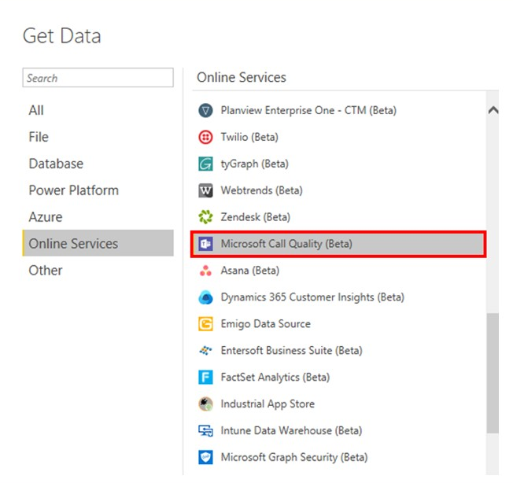
Analyze call quality by using CQD Power BI Connector
Install and setup Microsoft Call Quality Power BI Connector
Build queries
CQD Power BI templates:
CQD Helpdesk Report.pbit
CQD Location Enhanced Report.pbit
CQD Mobile Device Report.pbit
CQD PSTN Direct Routing Report.pbit
CQD Summary Report.pbit
CQD Teams Utilization Report.pbit
CQD User Feedback (Rate My Call) Report.pbit

Slide 35
Lab: Manage communication in Microsoft Teams

Slide 36
Lab exercises
Exercise 1: Manage Live event and meetings experiences
Exercise 2: Manage phone numbers
Exercise 3: Manage Phone System for Microsoft Teams

Slide 37
Closing slide

